Slide 1

East coast railway headquarters, bhubaneswar
Information technology cell
C1 Group Project Presentation
On
Asset Management System
Team Members:-
Dibya Ranjan Nayak Aparajita P. Patra
Aditya Kumar Sahoo Ipshika Mohapatra
Asutosh Singh Deo Bijayeeni Nayak
Nitin Arya

Slide 2
Contents
1. Introduction
2. Problem Statement
3. Objective
4. Technology Used
5. Features
6. Flowchart
7. Results
8. Future Scope
9. Conclusion

Slide 3
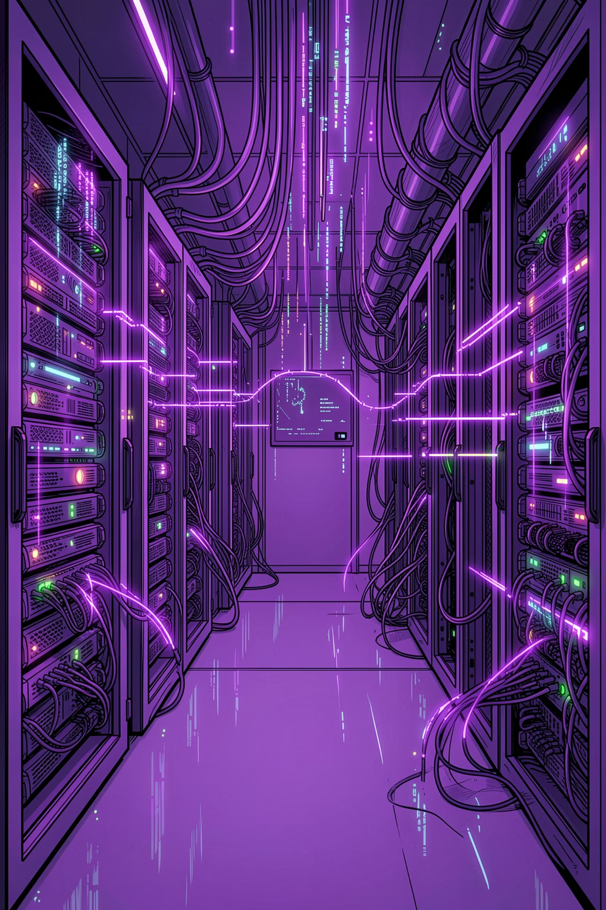
Introduction
A web-based system designed to manage and track organizational assets efficiently.
Helps maintain asset details such as asset name, category, location, status, and assigned information.
Provides an organized way to add, view, update, and manage asset records.
Reduces manual record-keeping and improves accuracy in asset tracking.
Built as a project focused on simple asset management without login authentication or email notification features.

Slide 4
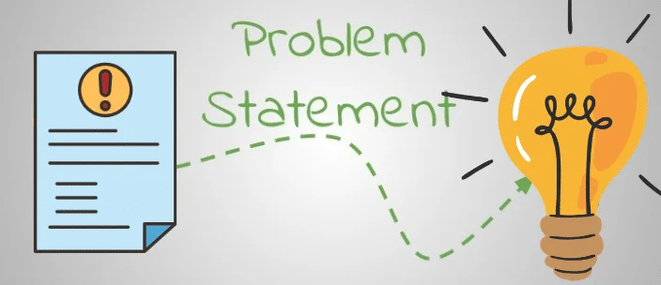
Problem Statement
Challenges in Asset Management System:
Managing organizational assets manually can be time-consuming and difficult to maintain.
Asset details may get scattered across registers, spreadsheets, or different files.
Manual tracking can lead to errors, duplicate records, missing information, or outdated asset status.
Searching and updating asset information becomes inefficient as the number of assets increases.
There is a need for a centralized system to store, view, update, and manage asset records easily.

Slide 5

Objective
To develop a web-based Asset Management System for maintaining asset records in a centralized way.
To allow easy addition, viewing, updating, and management of asset details.
To reduce manual record-keeping and improve the accuracy of asset information.
To make asset tracking faster, more organized, and easier to access.
To provide a simple and user-friendly interface for managing asset data.

Slide 6
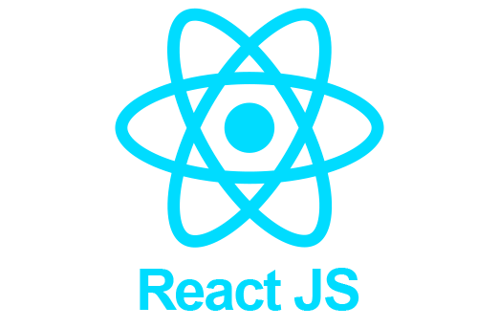
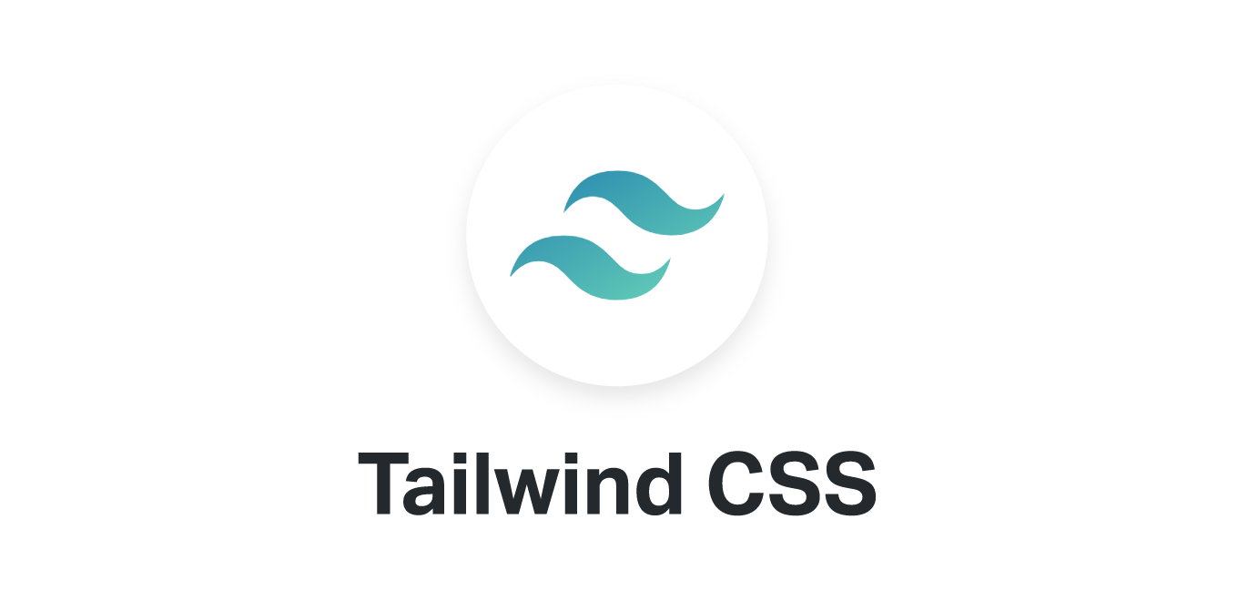
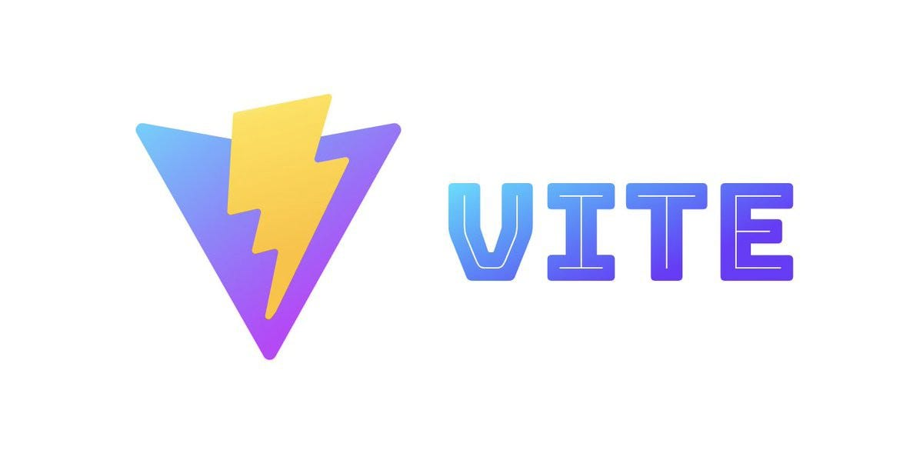

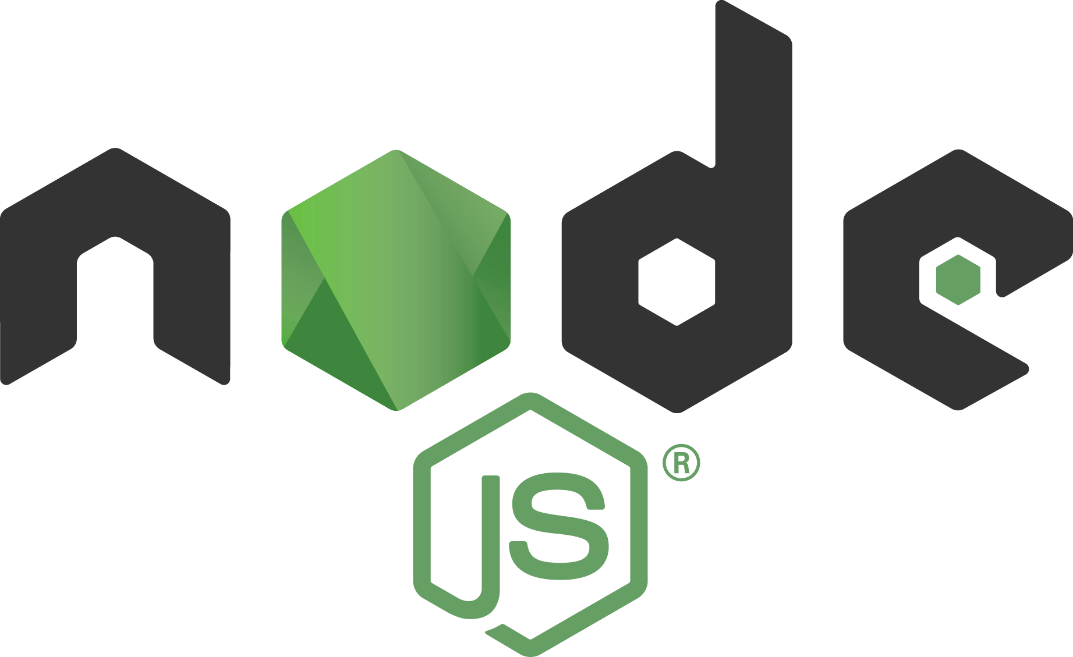
Technology Used
Frontend:-
React.js: Used for building the user interface.
Vite: Used for fast frontend development and build setup.
Tailwind CSS: Used for styling and responsive design.
React Router: Used for navigation between pages.
Axios: Used for API communication with the backend.
Backend:-
Node.js: Runtime environment for the server.
Express.js: Used to create backend routes and APIs.
REST API: Used for communication between frontend and backend.

Slide 7

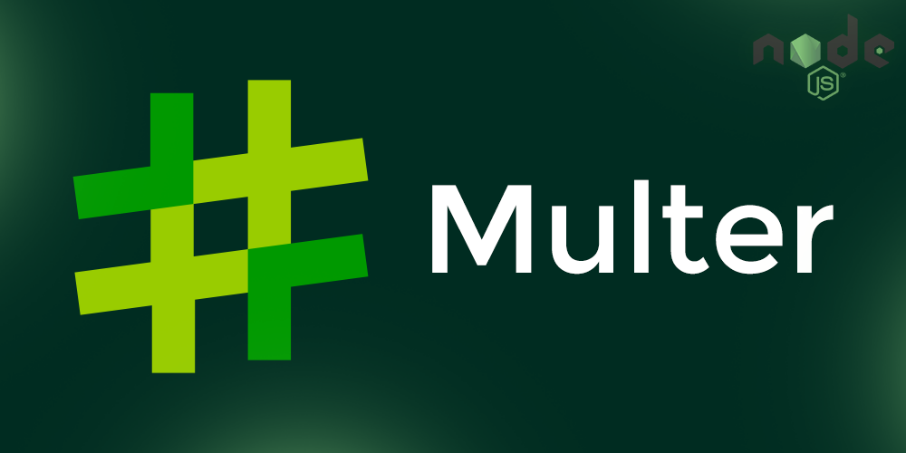
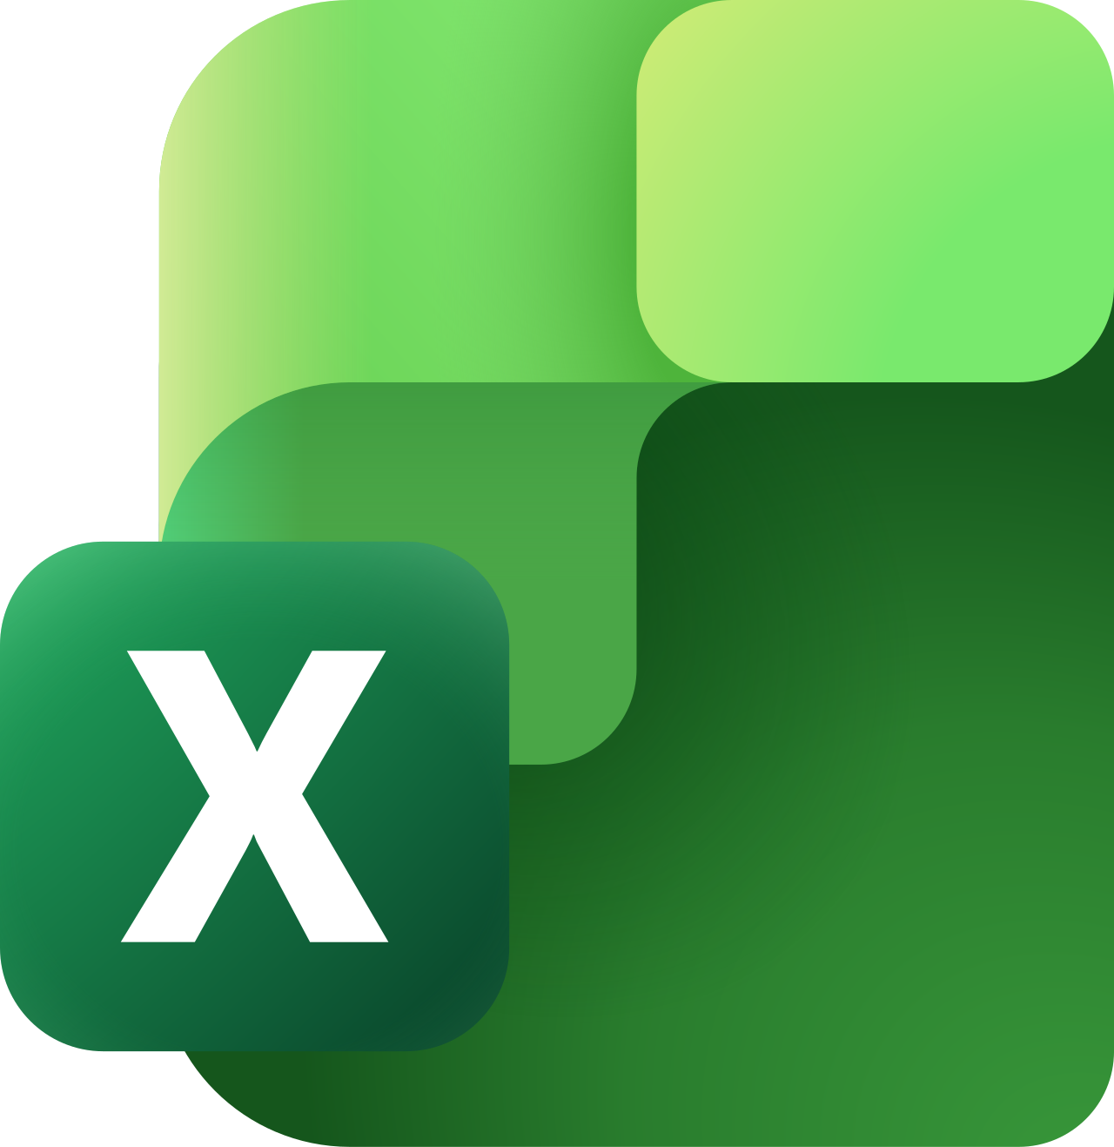

Database:-
MongoDB: Used to store asset-related data.
Mongoose: Used for database schema creation and MongoDB interaction.
Utilities:-
Multer: Used for handling file uploads.
QRCode: Used for generating QR codes for assets.
XLSX: Used for Excel file import/export functionality.
dotenv: Used for managing environment variables.
CORS: Used to allow communication between frontend and backend.

Slide 8

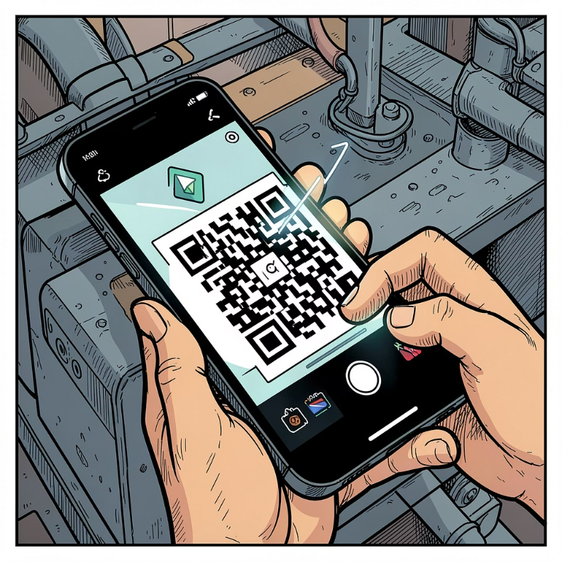
Features
Asset Allocation & Record Management: Allocate, track, and maintain asset records in one centralized system.
Asset Categorization: Organize assets based on categories for easier tracking.
Search and Filter: Quickly find required asset records from the system.
QR Code Generation: Generate QR codes for assets to make identification easier.
File Upload Support: Upload related asset files or documents using Multer.
Excel Import/Export: Handle asset data using Excel files through XLSX.
Responsive Interface: User-friendly frontend built with React and Tailwind CSS.
Centralized Database: Store asset information securely in MongoDB.

Slide 9
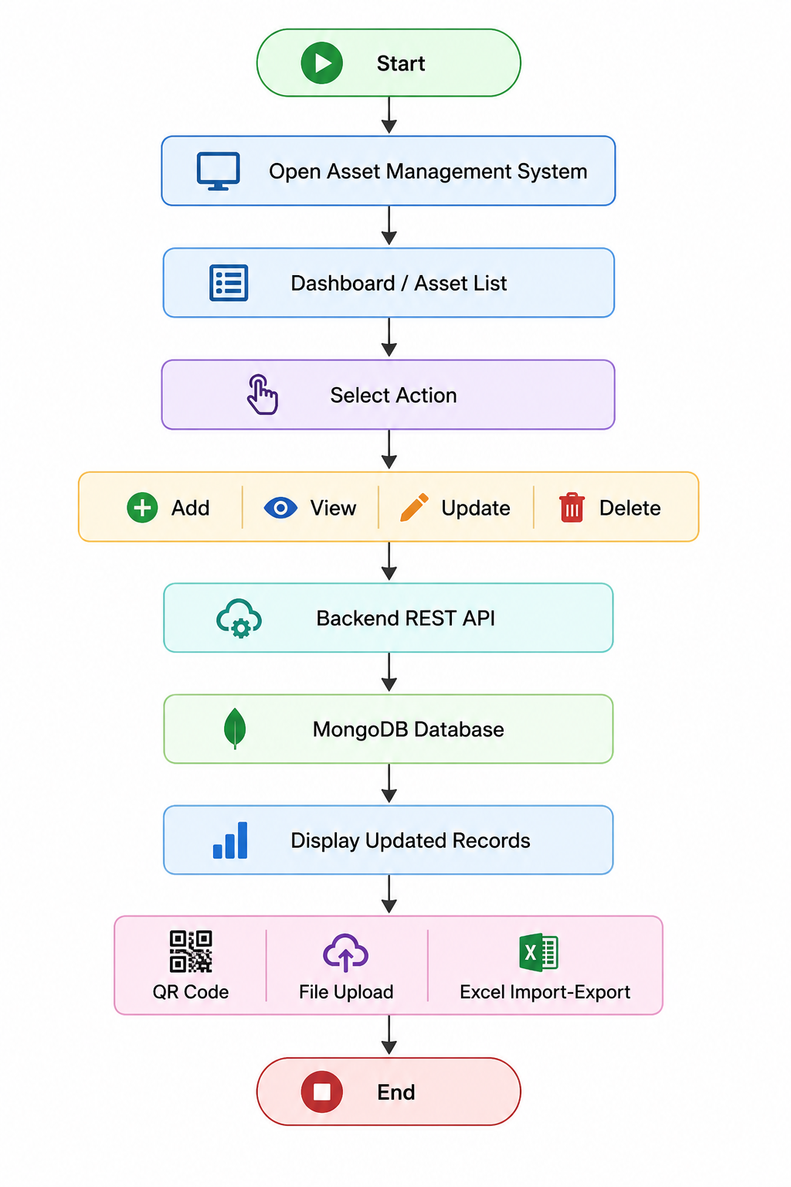
Flowchart

Slide 10

Results
The Asset Management System was successfully developed as a web-based application.
The system allows users to manage asset records digitally instead of using manual records.
Asset data can be added, viewed, updated, and maintained through a simple interface.
MongoDB stores the asset information, while REST APIs handle data communication.
QR code generation, Excel import-export, and file upload features were integrated successfully.
The final system provides an organized and user-friendly way to manage asset information.

Slide 11
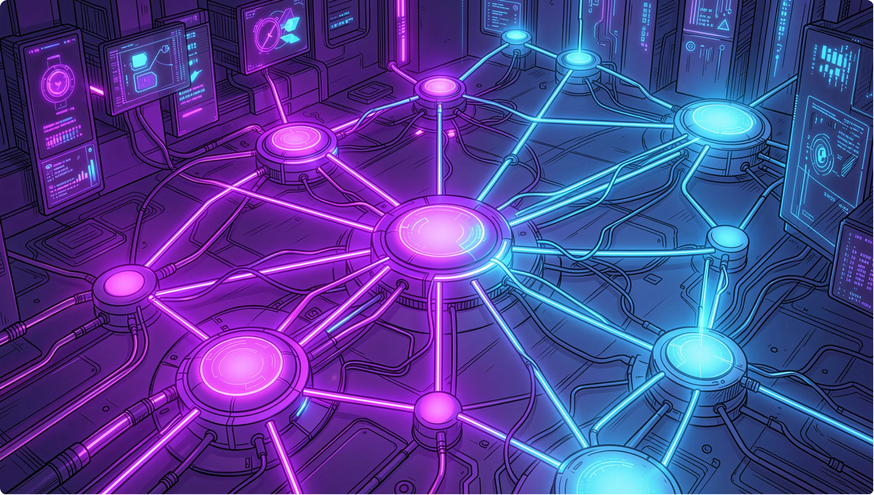
Future Scope
Login Authentication: Add secure user login for controlled system access.
Role-Based Access Control: Provide different permissions for admin, staff, and viewer roles.
Cloud Deployment: Deploy the application online for access from multiple devices and locations.
Mobile-Friendly Enhancements: Improve mobile responsiveness for easier use on phones and tablets.
Data Backup Scheduling: Add automatic scheduled backups for better data safety.

Slide 12
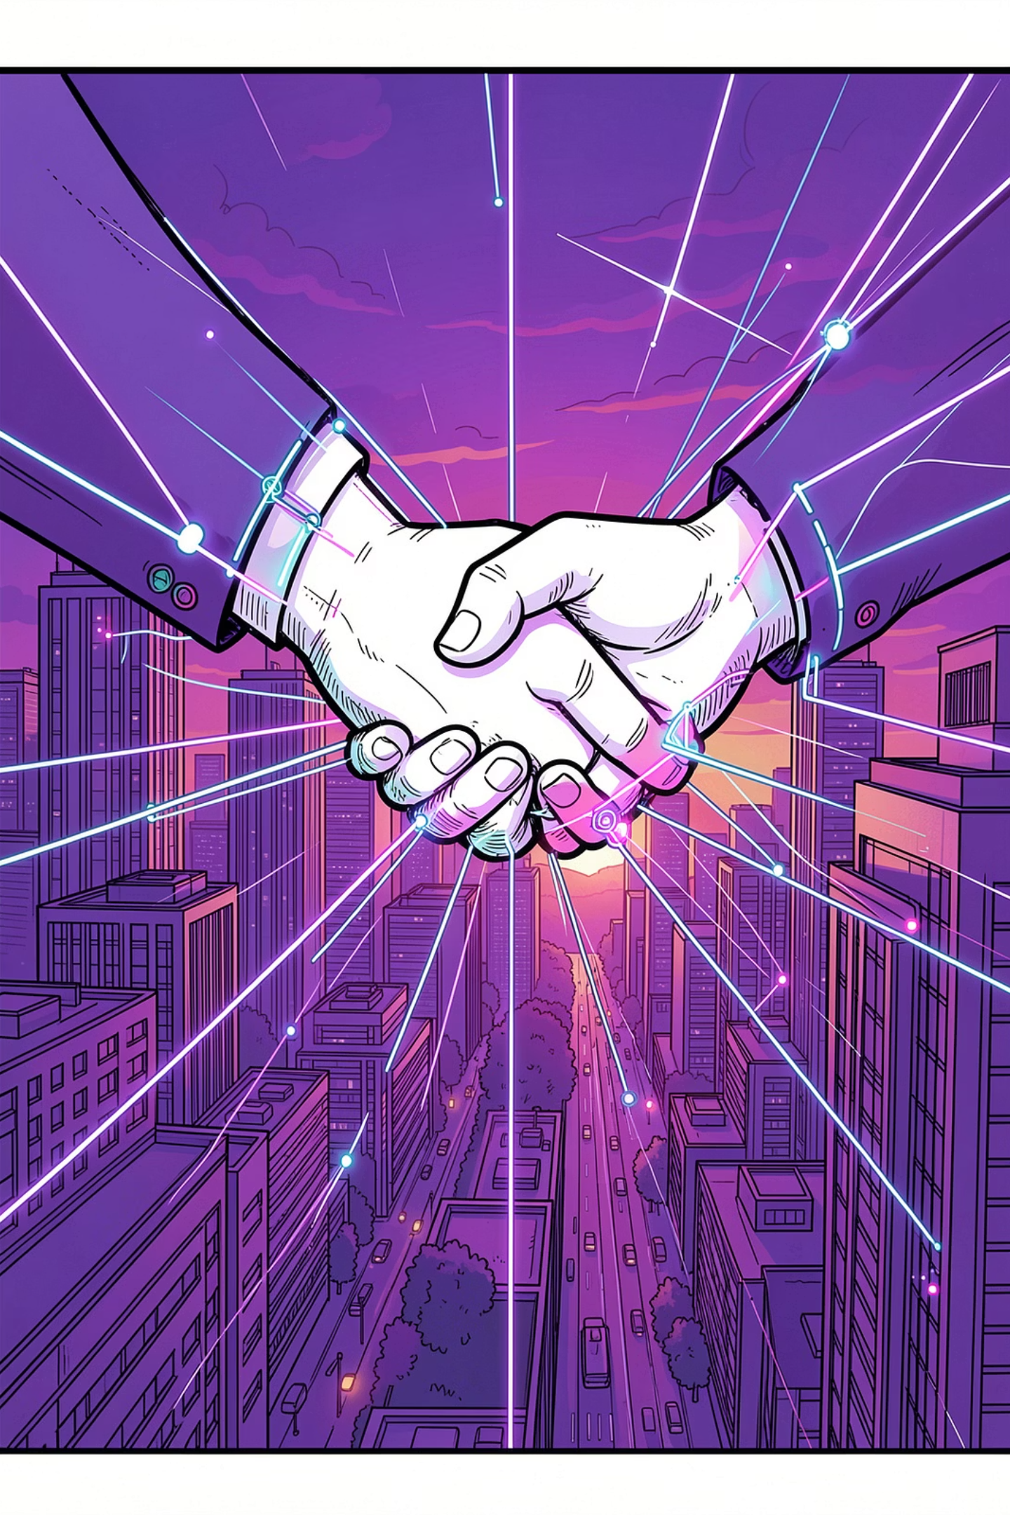
Conclusion
The Asset Management System was successfully developed as a web-based application.
It provides a centralized platform for managing asset records efficiently.
The system reduces manual work and improves the organization of asset information.
Features like QR code generation, Excel import-export, file upload, reports, and maintenance tracking make the system more useful.
MongoDB and REST APIs ensure smooth data storage and communication between frontend and backend.
The project can be further improved with login authentication, role-based access, and cloud deployment.

Slide 13
THANK YOU

